Slide 1
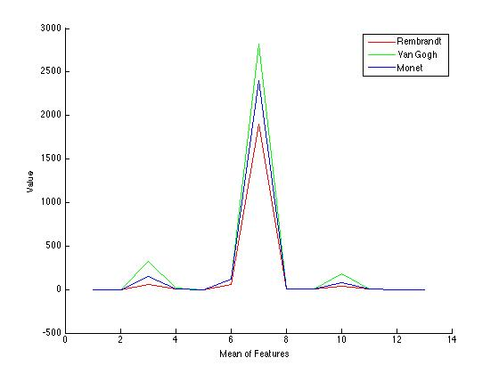
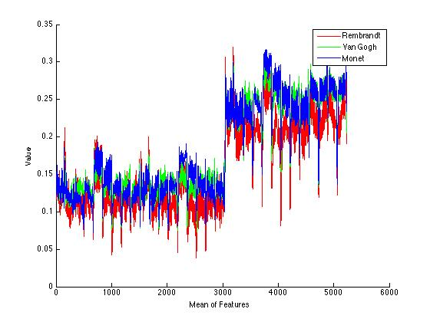
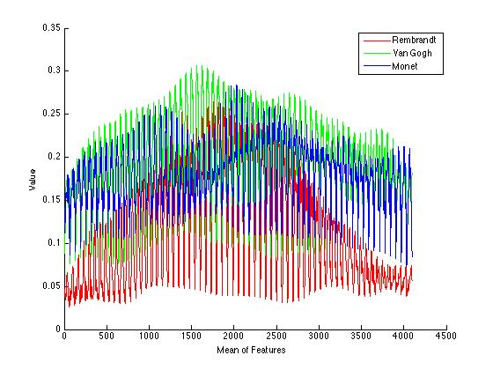
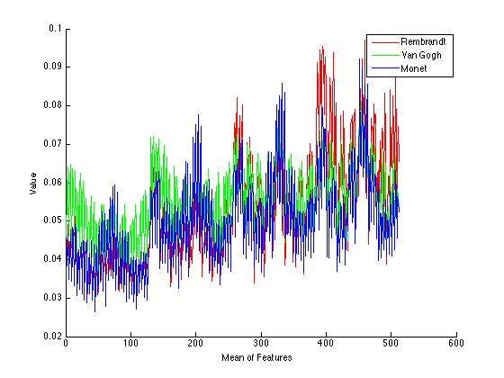
art classification using Computer Vision
Abstract
The aim of the project is to study paintings through the eyes of a computer. If Computer Vision is the science of making computers “see”, then the ability to notice the nuances in a painting is a lofty and challenging goal.
I use various standard CV image filtering techniques along with some improvised feature generation to build a model that can differentiate between the paintings of different artists. It's a difficult goal given that even human recognition for the task is not perfect.
Motivation
Computer Vision can assist art historians in analyzing paintings – since it can manipulate a dataset much larger. It can also perform objective analysis and discover subtleties in an image not visible to the naked eye. TODO: add vision strength here.
Dataset
The dataset used for the experiments consists of 3 different master painters – Rembrandt, Van Gogh and Monet. They were chosen devoid of and pre-conception of style. Rembrandt is know for luxurious brushwork, rich colors and a mastery of chiaroscuro (This was particularly helpful in classification given the drastic changes in intensity). Van Gogh is a post-impressionist painter, who painted with meticulous brushstrokes and bold colors. Monet too was an impressionist painter and drew many landscapes. The dataset consisted of 40 Rembrandt, 65 Van Gogh and 54 Monet paintings.
Method
Texture
I have used Haralick features to determine the texture of the painting. Haralick features are computed using the gray-level co-occurence matrix of the image. For each gray level, the number of occurrences for each other gray level value is stored for various directions (horizontal, diagonal etc.). Then 14 different statistical measures such as correlation, moment, entropy, variance etc. are calculated from the image. It's one of the most effective metrics.
Linear – 67.69%
Chi-Squared – 71.79%
Confusion Matrix
8 2 0
0 11 5
2 2 9
Histogram Oriented Gradient
I use HOG features for key-point detection within paintings. First, each image is resized to a 100 x 100 image since HOG is scale invariant. After that it calculates descriptors of size 13 x 13 x 31, given a cell size of 8. HOG gives the best performance of all the features and that's largely due to the fact that it is able to exploit the nature of the brush strokes of painters.
Linear – 73.84%
Confusion Matrix
8 1 1
2 12 2
0 3 10
Saliency Map
Saliency maps are used to detect the most important points in an image. They try to model the points in the image that are most likely to draw visual attention. The implementation used is a simple one and based on the Itti algorithm. The main idea is to compute the dissimilarity of a pixel from its neighbours.
The image is first resized to 100 x 100, and the saliency map is calculated with a blurRadius of 4 and standard deviation of 4. 4 Gabor angles (0, 45, 90 and 135) are used.
Linear – 56.47%
Confusion Matrix
7 2 1
4 9 3
3 4 6
Shape (GIST)
The GIST descriptors are used to characterize the overall shape and spatial nature of the image. It is computed by first resizing the image to 256 x 256, and then over 4 different scales, with eight orientations per scale.
Linear – 66.64%
Chi-Squared – 67.68%
Confusion Matrix
9 1 0
1 9 6
1 2 10

